Slide 1
OSI MODEL

Slide 2
Layer Architecture
Layer architecture simplifies the network design.
It is easy to debug network applications in a layered architecture network.
The network management is easier due to the layered architecture.
Network layers follow a set of rules, called protocol.
The protocol defines the format of the data being exchanged, and the control and timing for the handshake between layers.

Slide 3
Open Systems Interconnection (OSI) Model
International standard organization (ISO) established a committee in 1977 to develop an architecture for computer communication.
Open Systems Interconnection (OSI) reference model is the result of this effort.
In 1984, the Open Systems Interconnection (OSI) reference model was approved as an international standard for communications architecture.
Term “open” denotes the ability to connect any two systems which conform to the reference model and associated standards.

Slide 4
OSI Reference Model
The OSI model is now considered the primary Architectural model for inter-computer communications.
The OSI model describes how information or data makes its way from application programmes (such as spreadsheets) through a network medium (such as wire) to another application programme located on another network.
The OSI reference model divides the problem of moving information between computers over a network medium into SEVEN smaller and more manageable problems .
This separation into smaller more manageable functions is known as layering.

Slide 5
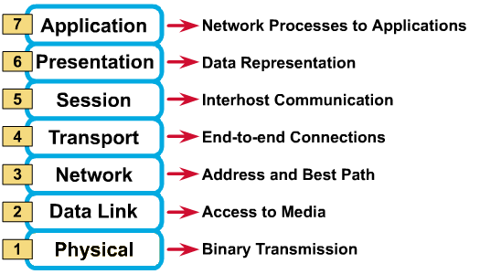
OSI Reference Model: 7 Layers

Slide 6
Physical Layer
Provides physical interface for transmission of information.
Defines rules by which bits are passed from one system to another on a physical communication medium.
Covers all - mechanical, electrical, functional and procedural - aspects for physical communication.
Such characteristics as voltage levels, timing of voltage changes, physical data rates, maximum transmission distances, physical connectors, and other similar attributes are defined by physical layer specifications.

Slide 7
Data Link Layer
Data link layer attempts to provide reliable communication over the physical layer interface.
Breaks the outgoing data into frames and reassemble the received frames.
Create and detect frame boundaries.
Handle errors by implementing an acknowledgement and retransmission scheme.
Implement flow control.
Supports points-to-point as well as broadcast communication.
Supports simplex, half-duplex or full-duplex communication.

Slide 8
Network Layer
Implements routing of frames (packets) through the network.
Defines the most optimum path the packet should take from the source to the destination
Defines logical addressing so that any endpoint can be identified.
Handles congestion in the network.
Facilitates interconnection between heterogeneous networks (Internetworking).
The network layer also defines how to fragment a packet into smaller packets to accommodate different media.

Slide 9
Ethernet Data-Link Protocols

Slide 10
Ethernet Data-Link Protocols
One of the most significant strengths of the Ethernet family of
protocols is that these protocols use the same data-link
standard. In fact, the core parts of the data-link standard date
back to the original Ethernet standards.
The Ethernet data-link protocol defines the Ethernet frame: an
Ethernet header at the front, the encapsulated data in the
middle, and an Ethernet trailer at the end. Ethernet actually
defines a few alternate formats for the header,

Slide 11
The source and destination Ethernet address fields play a huge role in how Ethernet LANs work. The general idea for each is relatively simple: The sending node puts its own address in the source address field and the intended Ethernet destination device’s address in the destination address field. The sender transmits the frame, expecting that the Ethernet LAN, as a whole, will deliver the frame to that correct destination.

Slide 12
Ethernet addresses
also called Media Access Control (MAC) addresses, are 6-byte-long (48-bit-long) binary numbers. For convenience, most computers list MAC addresses as 12-digit hexadecimal numbers. Cisco devices typically add some periods to the number for easier readability as well; for example, a Cisco switch might list a MAC address as 0000.0C12.3456

Slide 13
Most MAC addresses represent a single NIC or other Ethernet port, so these addresses are often called a unicast Ethernet address. The term unicast is simply a formal way to refer to the fact that the address represents one interface to the Ethernet LAN

Slide 14
The entire idea of sending data to a destination unicast MAC
address works well, but it works only if all the unicast MAC
addresses are unique. If two NICs tried to use the same MAC
address, there could be confusion. (The problem would be like
the confusion caused to the postal service if you and I both tried
to use the same mailing address. Would the postal service
deliver mail to your house or mine?) If two PCs on the same
Ethernet tried to use the same MAC address, to which PC should
frames sent to that MAC address be delivered?

Slide 15
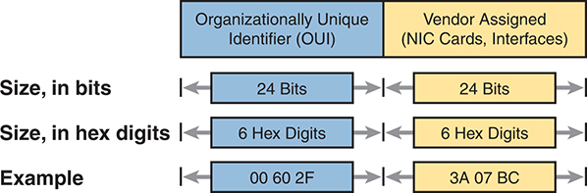

Slide 16
Broadcast address
Frames sent to this address should be delivered to all devices on the Ethernet LAN. It has a value of
FFFF.FFFF.FFFF.

Slide 17
Internet Protocol Addressing Basics

Slide 18
IP defines addresses for several important reasons.
First, each device that uses TCP/IP—each TCP/IP host—needs a unique address so that it can be identified in the network.
IP also defines how to group addresses together, just like the postal system groups addresses based on postal codes (like ZIP codes in the United States).

Slide 19
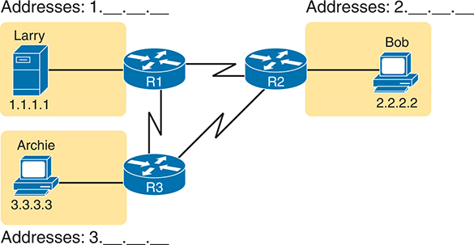
to understand the basics, examine Figure, which shows the familiar web server Larry and web browser Bob; but now, instead of ignoring the network between these two computers, part of the network infrastructure is included.
Broadcast address
Broadcast address

Slide 20
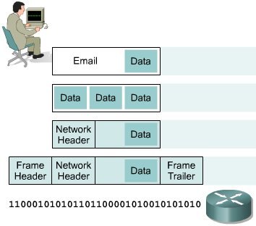
IP as a Routed Protocol
IP is a connectionless, unreliable, best-effort delivery protocol.
IP accepts whatever data is passed down to it from the upper layers and forwards the data in the form of IP Packets.
All the nodes are identified using an IP address.
Packets are delivered from the source to the destination using IP address

Slide 21
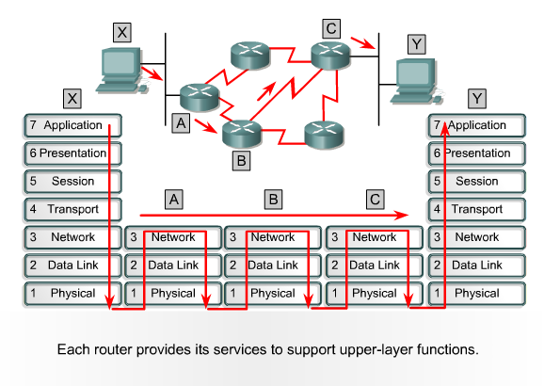
Packet Propagation

Slide 22
IP Address
IP address is for the INTERFACE of a host. Multiple interfaces mean multiple IP addresses, i.e., routers.
32 bit IP address in dotted-decimal notation for ease of reading, i.e., 193.140.195.66
Address 0.0.0.0, 127.0.0.1 and 255.255.255.255 carries special meaning.
IP address is divided into a network number and a host number.
Also bits in Network or Host Address cannot be all 0 or 1.

Slide 23
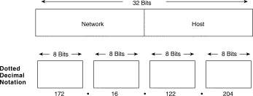
IP Address

Slide 24
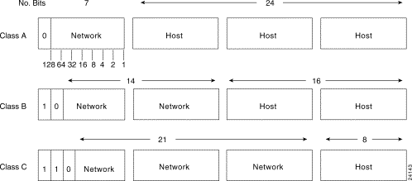
IP Address

Slide 25
IP Address
Class A : Address begins with bit 0. It has 8 bit network number (range 0.0.0.0-to-127.255.255.255), 24 bit host number.
Class B : Address begins with bits 10. It has 16 bit network number (range 128.0.0.0-to-191.255.255.255), 16 bit host number.
Class C : Address begins with bits 110. It has 24 bit network number (range 192.0.0.0-to-223.255.255.255), 8 bit host number.
Class D : Begins with 1110, multicast addresses (224.0.0.0-to-239.255.255.255)
Class E : Begins with 11110, unused

Slide 26
Subnet Mask
Consider IP address = 192.168.2.25
First few bits (left to right) identify network/subnet
Remaining bits identify host/interface
Number of subnet bits is called subnet mask, e.g.
Subnet IP Address range is 192.168.2.0 – 192.168.2.255 or Mask = 255.255.255.0
Subnet IP Address range is 192.168.2.0 – 192.168.2.15 or Mask = 255.255.255.240

Slide 27
IP Address, Subnet Mask and Gateway
IP Address and Subnet Mask define the Subnet
For Example IP address 172.31.1.0 and Subnet Mask of 255.255.240.0 means that the subnet address ranges from 172.31.0.0 to 172.31.15.255
Another notation is 172.31.1.0/28
The first Address is the Network Address and the last Address is the Broadcast Address. They are reserved and cannot be assigned to any node.
The Gateway Address is the Address of the router where the packet should be sent in case the destination host does not belong to the same subnet

Slide 28
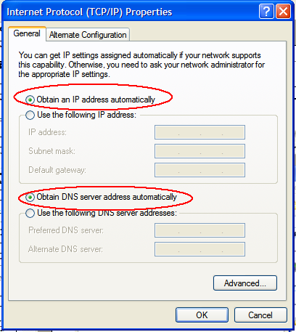
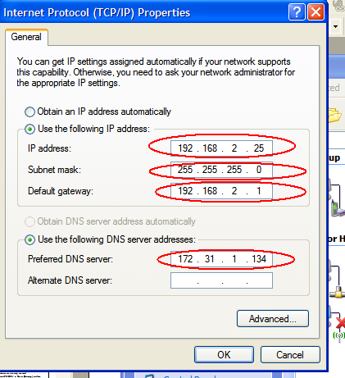
IP Configuration of an Interface
Static
DHCP

Slide 29
ARP
ARP (Address Resolution Protocol) is used in Ethernet Networks to find the MAC address of a node given its IP address.
Source node (say 192.168.2.32) sends broadcast message (ARP Request) on its subnet asking ``Who is 192.168.2.33’’.
All computers on subnet receive this request
Destination responds (ARP Reply) since it has 192.168.2.33
Provides its MAC address in response

Slide 30
Private vs Public IP Addresses
Whatever connects directly into Internet must have public (globally unique) IP address
There is a shortage of public IPv4 address
So Private IP addresses can be used within a private network
Three address ranges are reserved for private usage
10.0.0.0/8
172.16.0.0/16 to 172.31.0.0/16
192.168.0.0/24 to 192.168.255.0/24
A private IP is mapped to a Public IP, when the machine has to access the Internet

Slide 31
IPv6
Internet Protocol Version 4 is the most popular protocol in use today, although there are some questions about its capability to serve the Internet community much longer.
IPv4 was finished in the 1970s and has started to show its age.
The main issue surrounding IPv4 is addressing—or, the lack of addressing—because many experts believe that we are nearly out of the four billion addresses available in IPv4.
Although this seems like a very large number of addresses, multiple large blocks are given to government agencies and large organizations.
IPv6 could be the solution to many problems posed by IPv4

Slide 32
IPv6
IPv6 uses 128 bit address instead of 32 bit address.
The IPv6 addresses are being distributed and are supposed to be used based on geographical location.

